Slide 1
ISS Capstone Project ICS Security
By: Ahmed, Deep, Mike and Azzan

Slide 2
Topics
Industrial Control Systems
Need For Security
Devices Used
Network Topology
Demonstration
Q&A

Slide 3
Project Synopsis
Encryption to secure industrial SCADA
Used Autosol’s Cryptomod
RSA 2048 bit and AES 256 PKI
TLS and OpenSSL tunnels
FIPS 140-2 Compliant

Slide 4
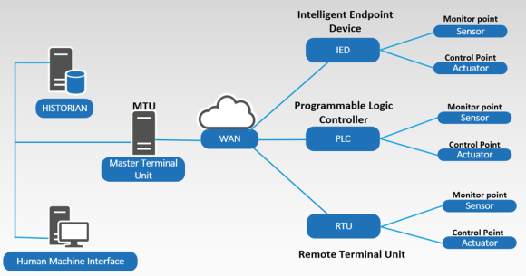
SCADA

Slide 5
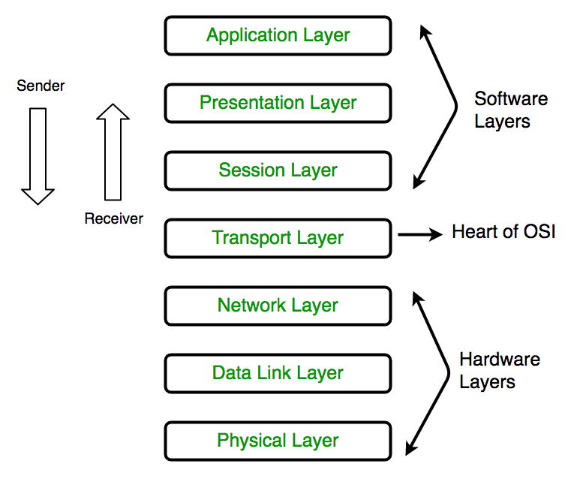
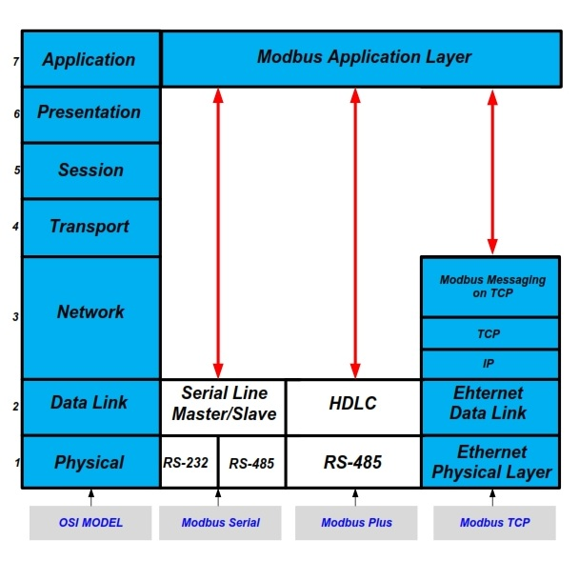
OSI layers vs ICS Modbus

Slide 6
Industrial Control Systems
Used to operate / automate industrial processes
Functions differently then IT – different protocols
Manufacturing, transportation, energy, and water treatment industries.

Slide 7
ICS Technologies
Supervisory control and data acquisition (SCADA)
Distributed control systems (DCS),
Industrial automation and control systems (IACS)
Programmable logic controllers (PLCs)

Slide 8
ICS Technologies
Programmable automation controllers (PACs)
Remote terminal units (RTUs)
Intelligent electronic devices (IEDs)
Sensors

Slide 9
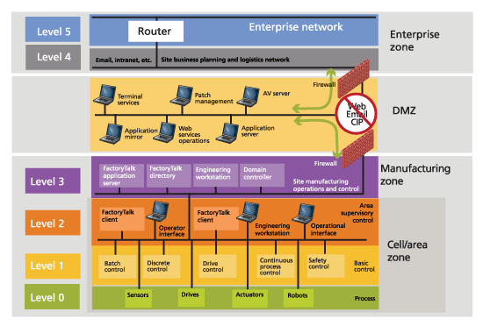
Purdue Enterprise Reference Architecture

Slide 10
Need for Security in SCADA over Modbus
Field Office
Head Office

Slide 11
Prevent Attacks!

Slide 12
Network Isolation in ICS One Way Devices
Corporate network hack has no effect!
Refinery safe! No KABOOM!

Slide 13
Devices Used
Toshiba Variable Frequency Drive (VFD)
Autosol Cyptomod
Host computer
Communication Manager/Client (ACM)
Schneider Radios 900-Mhz

Slide 14
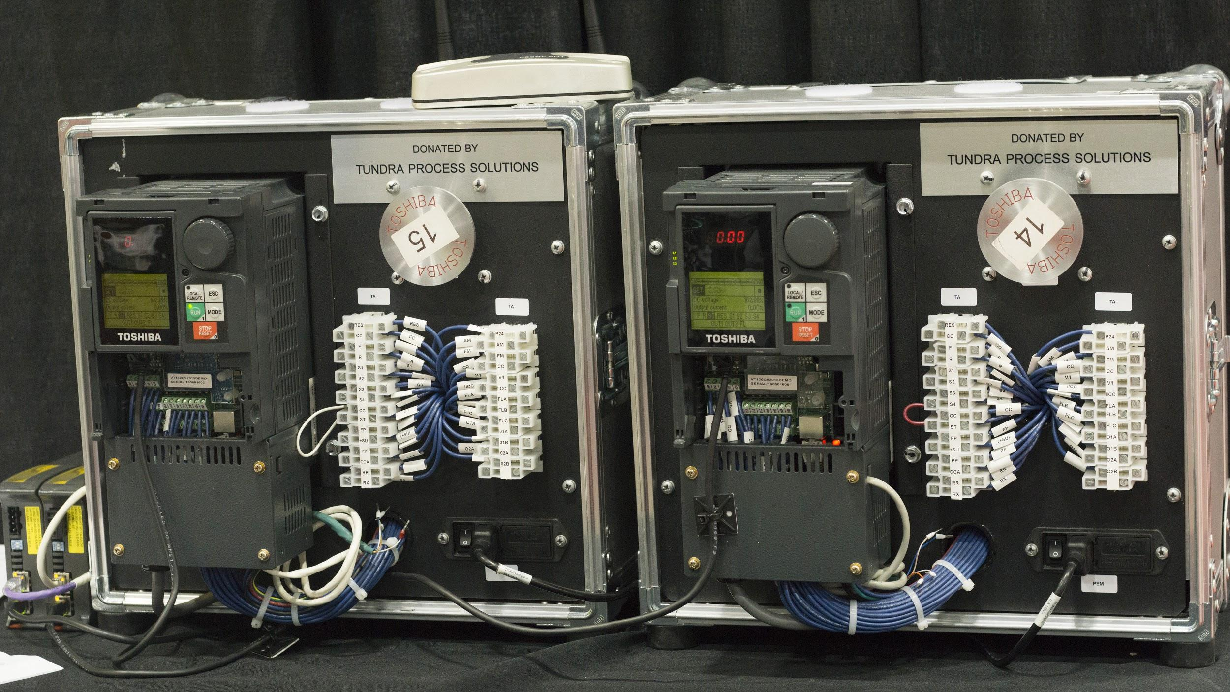
VFD (Variable Frequency Drive)
Speaks Modbus!

Slide 15
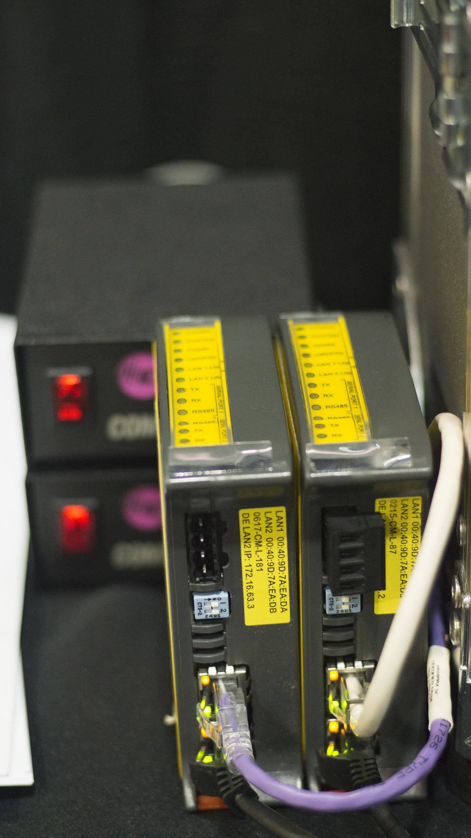
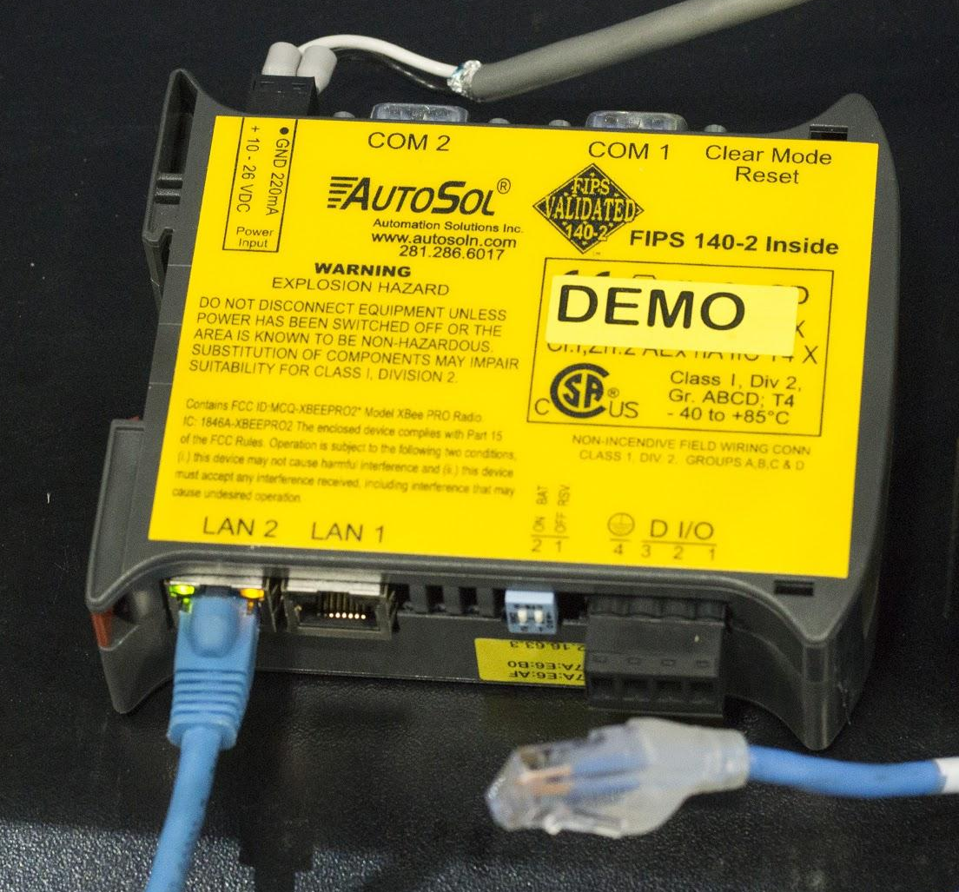
CryptoMod
Power Supply

Slide 16
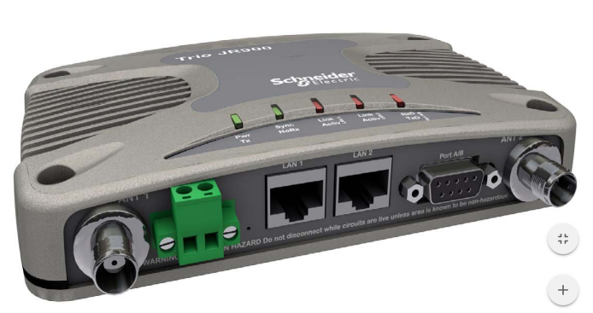
J SERIES Schneider Radio

Slide 17
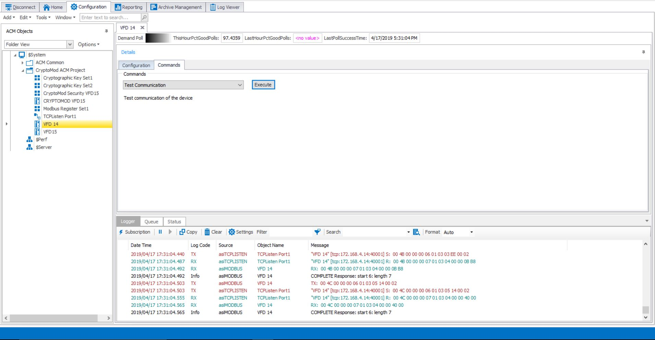
ACM (AutoSol Communication Manager)
Setup:
Devices
PKI Keys
Passwords
Check Communication
Input Commands
Logging Function

Slide 18
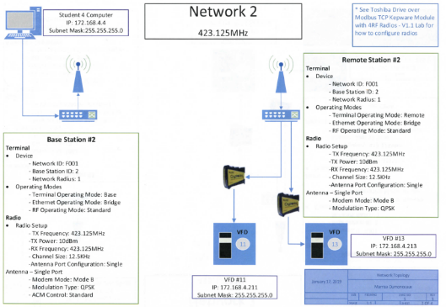
Network Topology

Slide 19
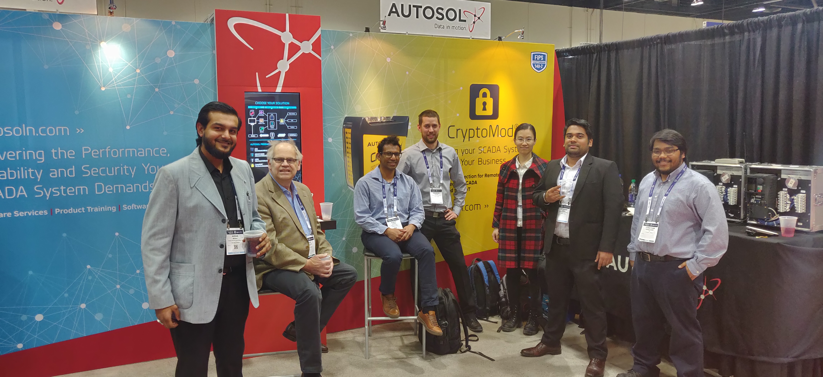
ISA Show

Slide 20
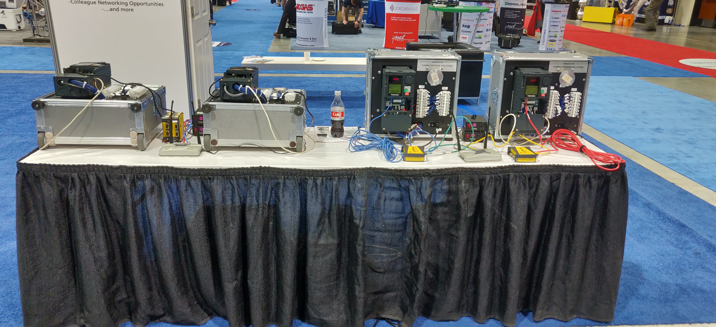
ISA Show (2)
Who owns the Coke?

Slide 21
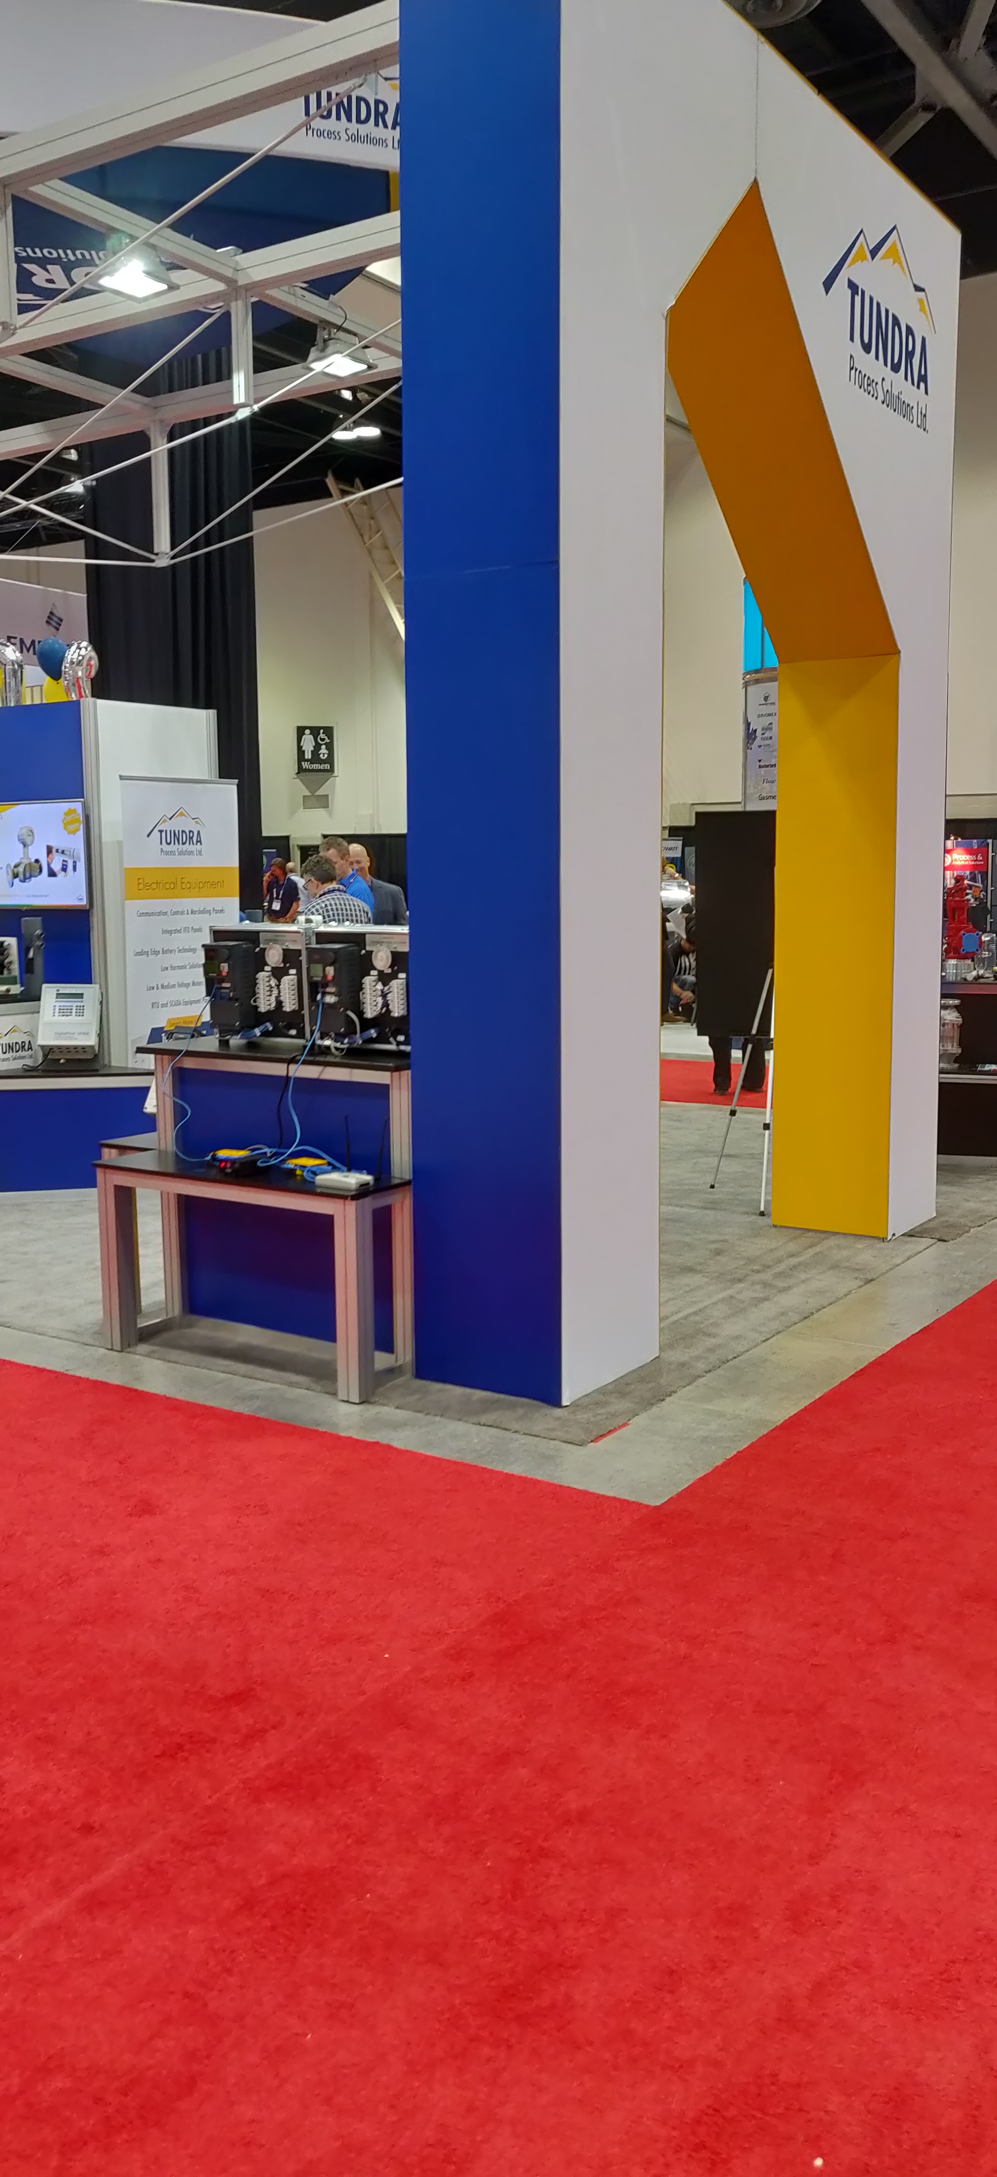
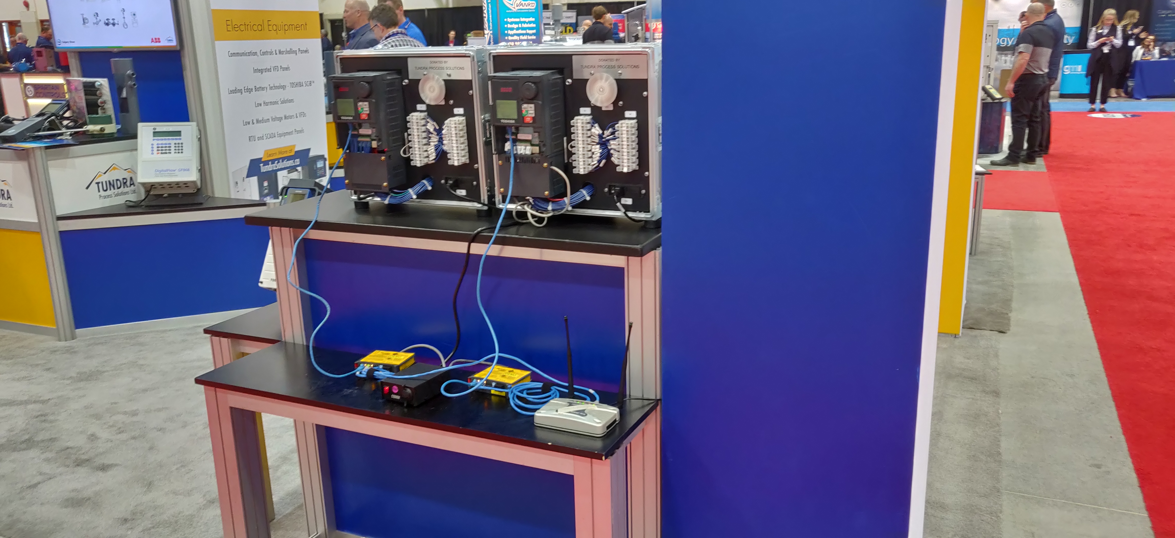
ISA Show (3)

Slide 22
Demo and Q&A

Slide 23
Conclusions
Good experience
Exposure ICS
Setup of CryptoMod
Application of Encryption
Trade show experience
People networking
Saw conference presentations
Instrument Tech program

Slide 24
The End

Slide 25
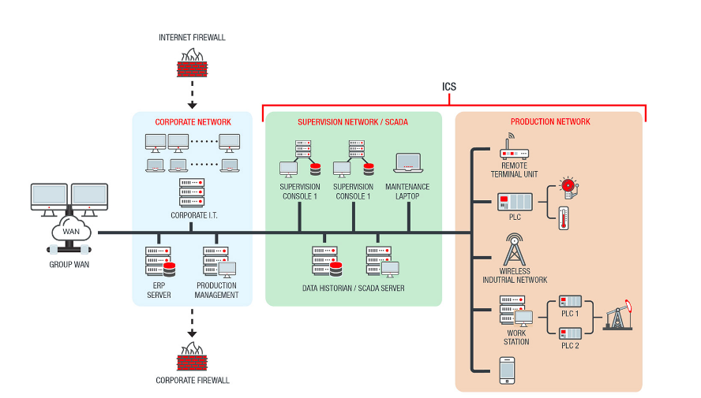
ICS Sample Network

Slide 26
